Slide 2
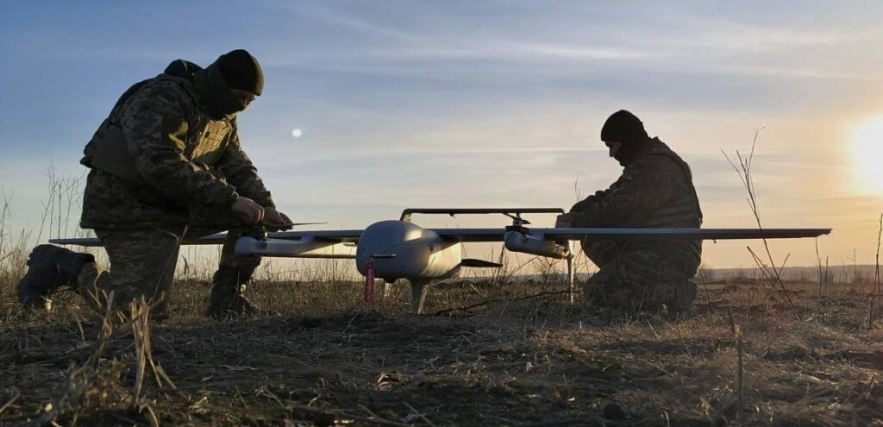
Rapidly growing branch of military

Slide 3
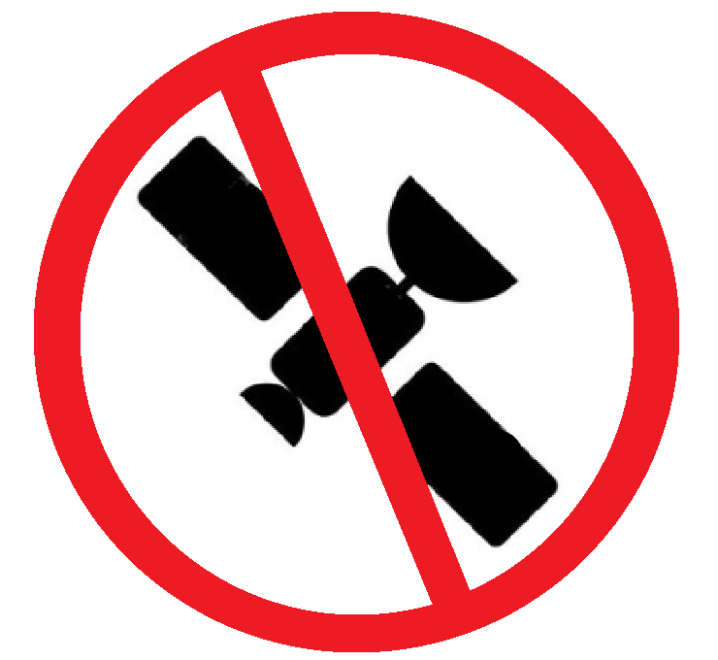


Offline navigation

Slide 4
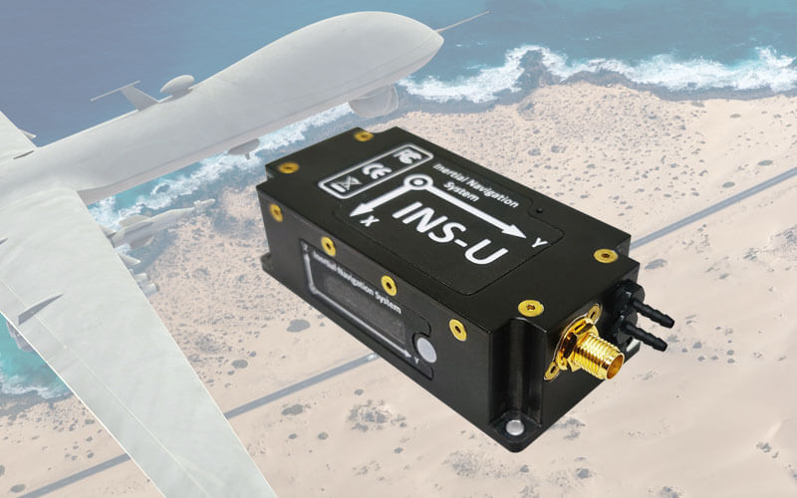
Existing navigation solutions

Slide 5

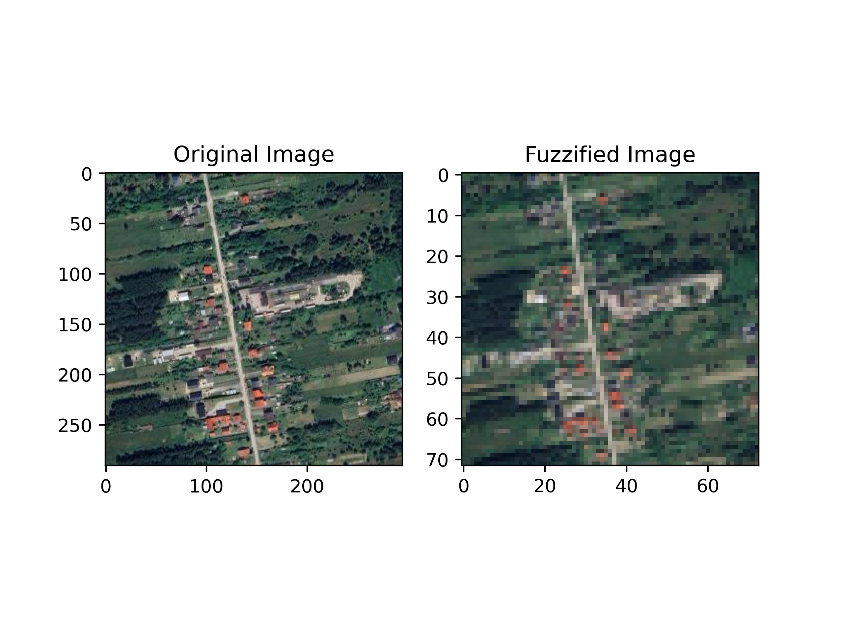
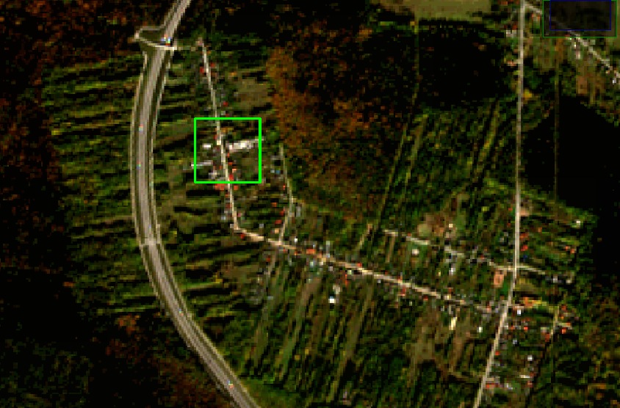
Pattern matching algorithm
Raw image
Fuzzyfied image

Slide 6
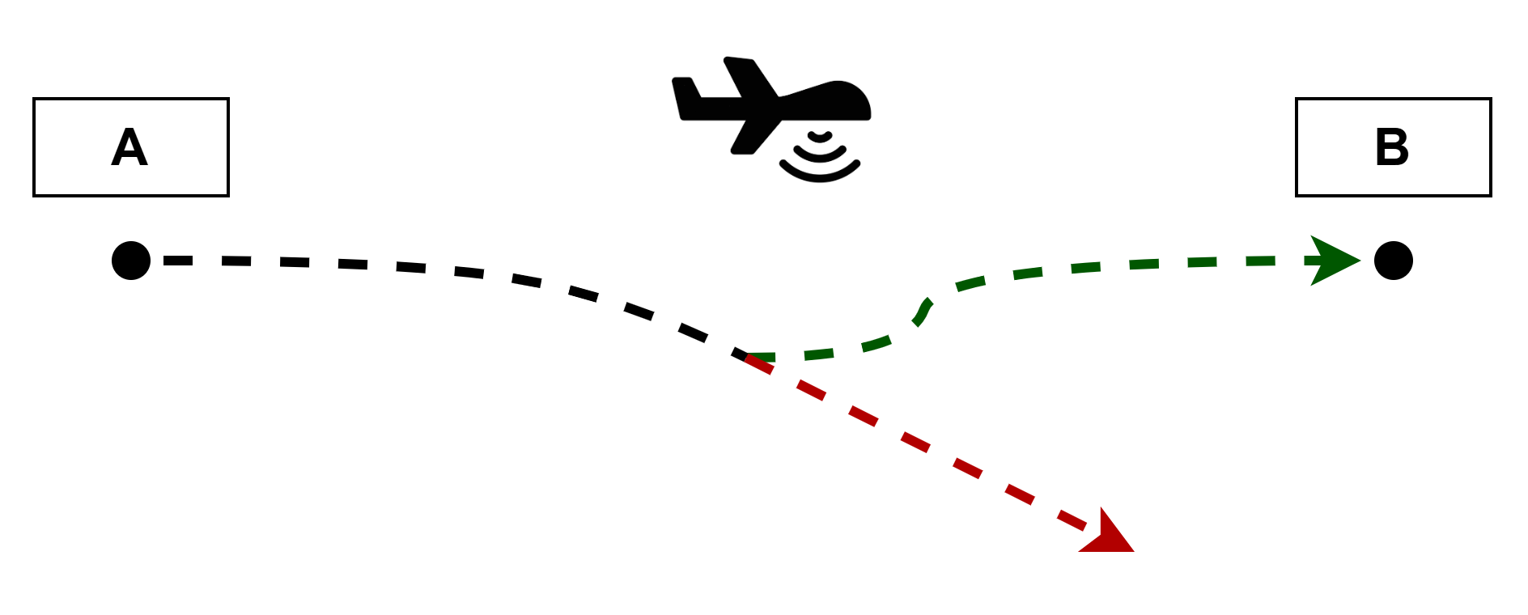
Combining technologies

Slide 7
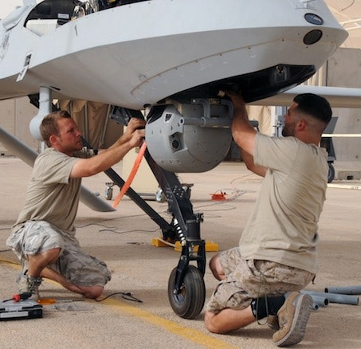
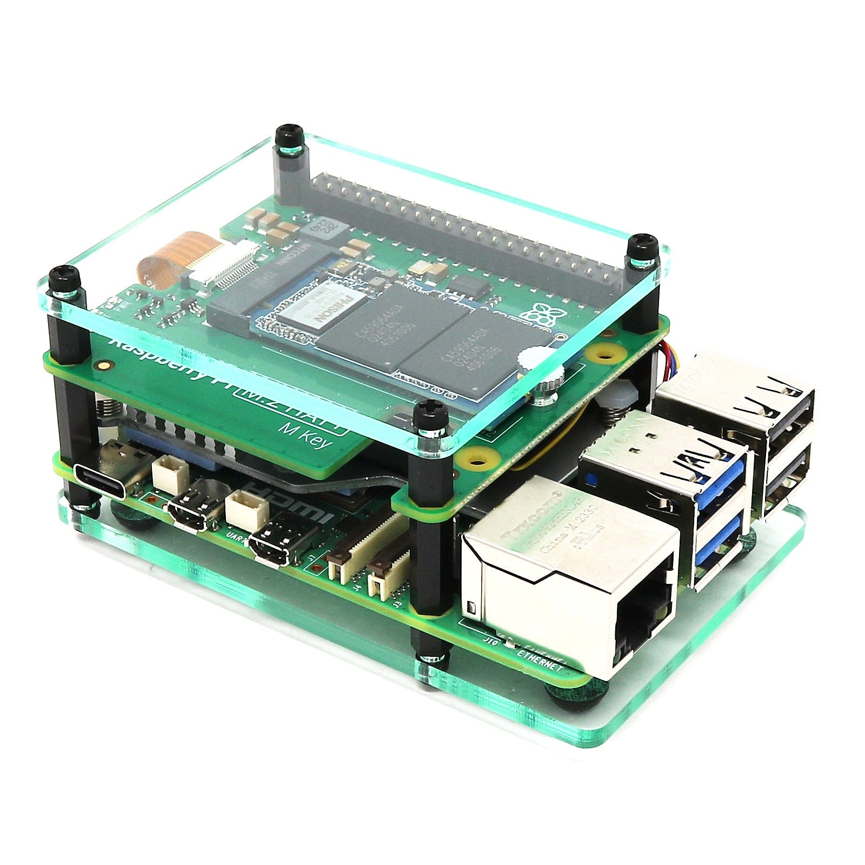
Plug and play modular system
Onboard sensors
Parallel processing advantage
Position correction using template matching
Use of local technology and supply chains

Slide 8
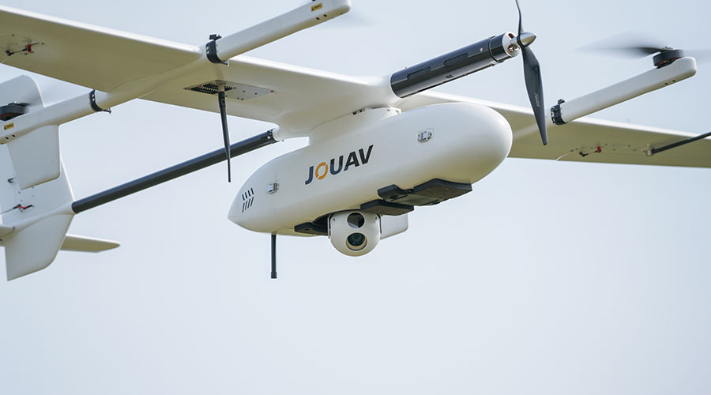
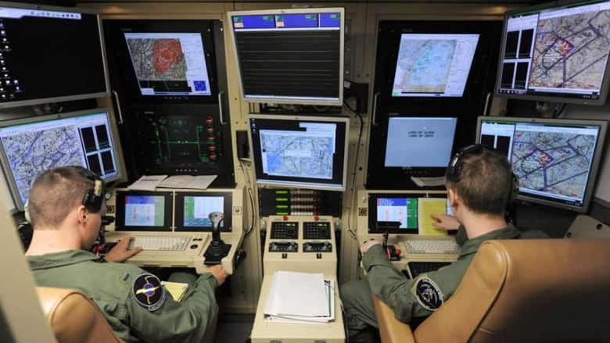
Low cost solution for demanding customers

Slide 9
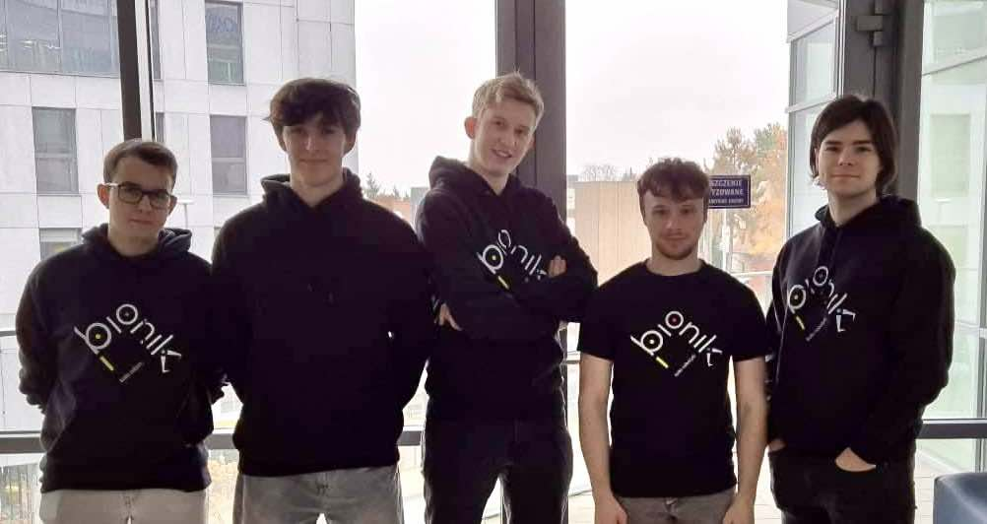
Our team

Slide 10
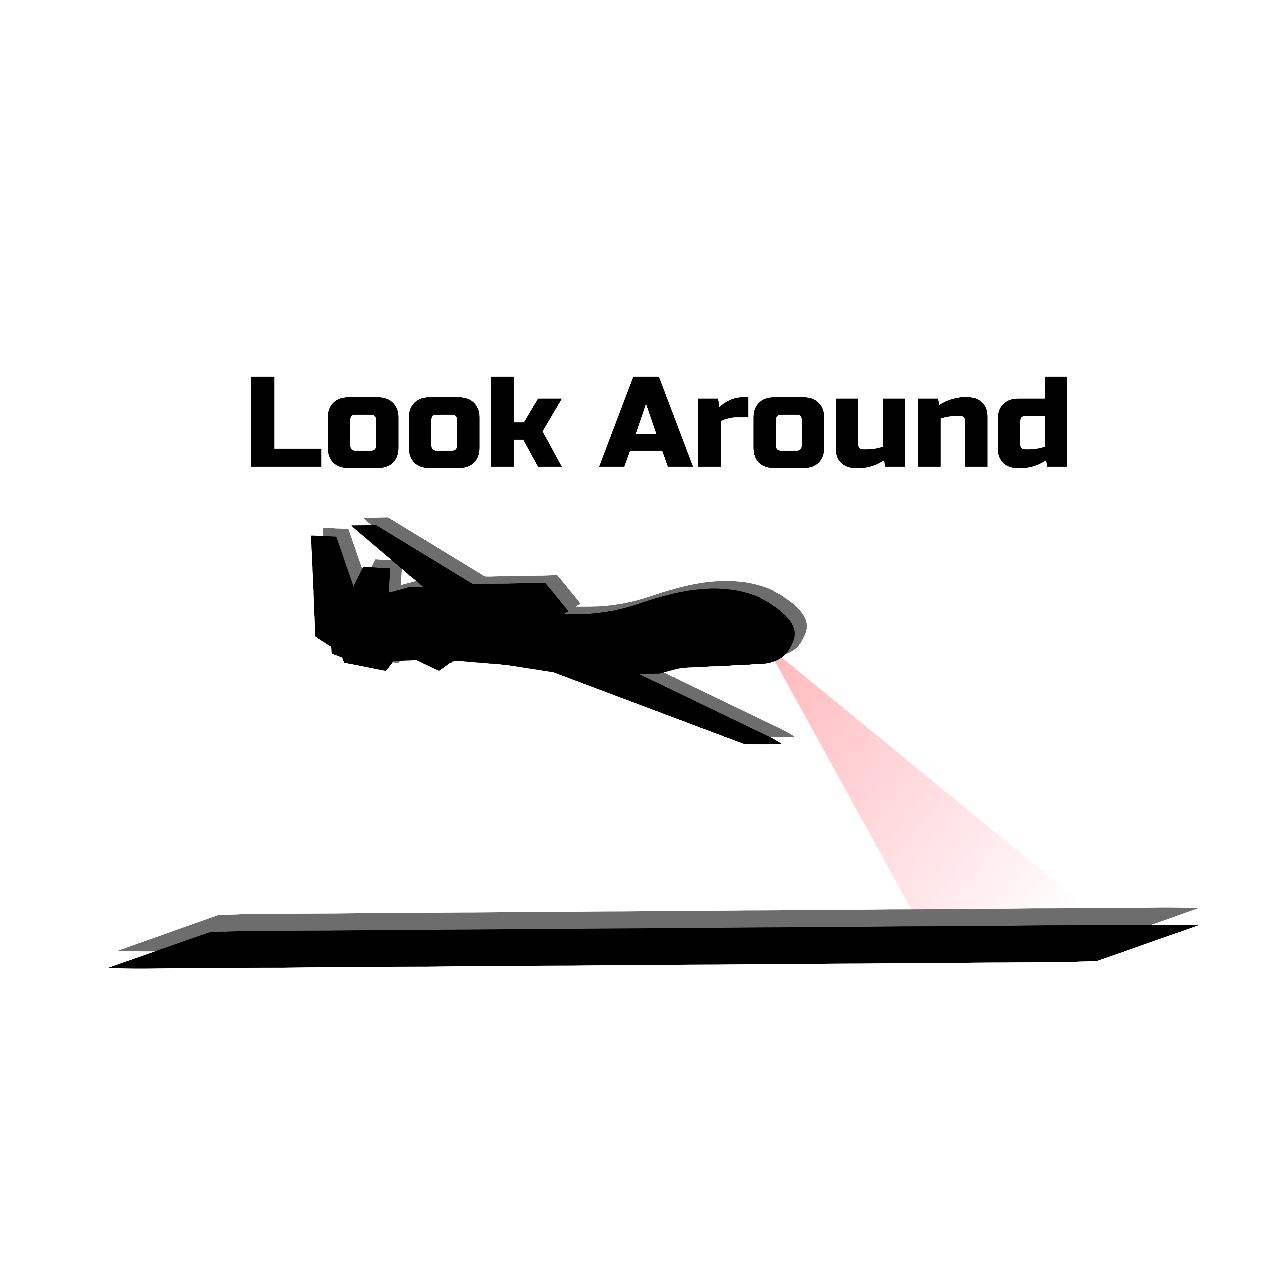
We encourage you to ask questions

Slide 11
Memory complexity
Sentinel-2 data offers a resolution of 10m x 10m
The data for the area of Poland is approximately 25GB in size which is far more than we need
Memory capacity should not pose an issue

Slide 12
Computational complexity
Our pattern matching algorithm, in a situation similar to reality, achieves an execution time of less than 0.03 seconds executed on a single core working at 3.4GHz
Time execution can be improved when deployed on Tensor Processing Unit perfectly suited for parallel applications
Raspberry Pi 5 with AI module can provide up to 25 TOPS and Jetson Nano up to 40 TOPS
The energy consumption and size of the controller should not pose an issue for large and medium-sized drones

Slide 13
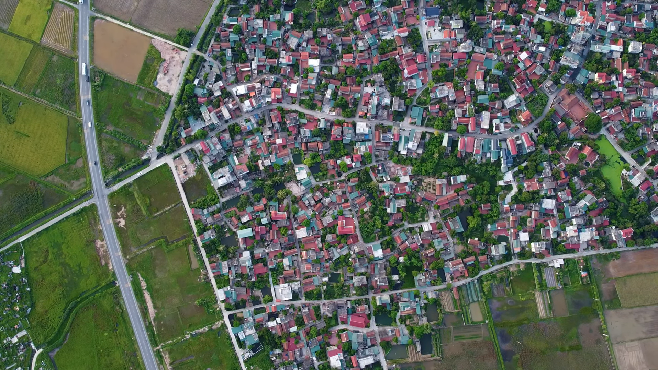
Flight altitude View from the 500 meters

Slide 14
Orthorectification
Orthorectification is the process of correcting a remote sensing image so that the physical scale across the image is uniform
This is known problem, fast algorithms exist
Orthorectification should not pose an issue

